Slide 1
Sentiment Analysis of Amazon Book Reviews
Naive Bayes Classifier
By:
Wajih Siddiqui (15153)
Mohsin Aslam (15157)
Roshan (13242)

Slide 2
Technologies Used:
Python
Pandas
Scikit Learn
Nltk
Jupyter Notebook

Slide 3
Steps:
- CSV to DataFrame - Create Vocabulary - Tokenize & Stemming reviews
- POS tagging - Split by train and test - Classify Data - Create Confusion Matrix - Convert ratings to binary values - Perform above for Unigrams and Bigrams - Create ROC

Slide 4
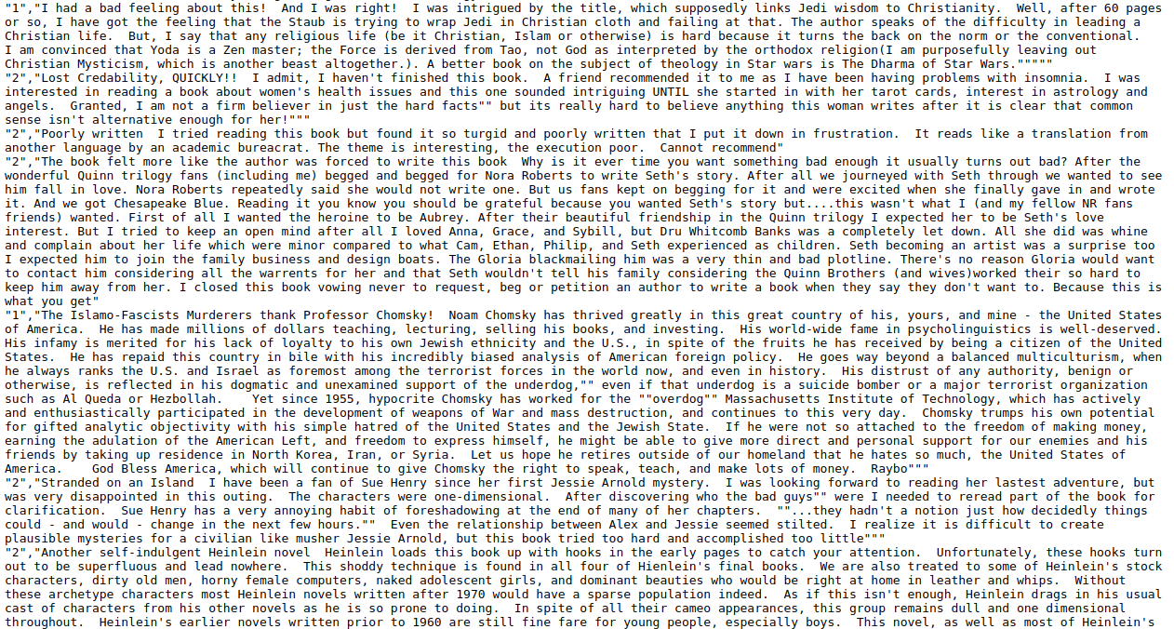
Data Set

Slide 5
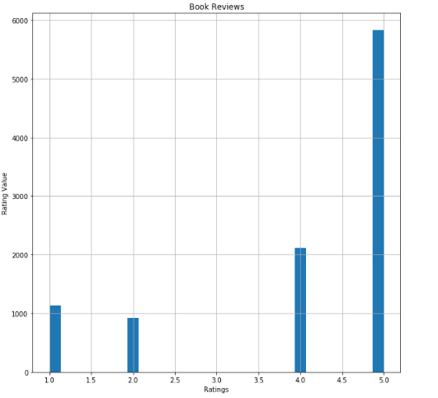
Imbalanced Class Problem

Slide 6
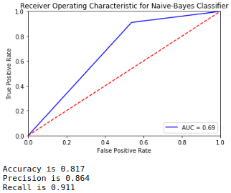
ROC With Unigrams

Slide 7
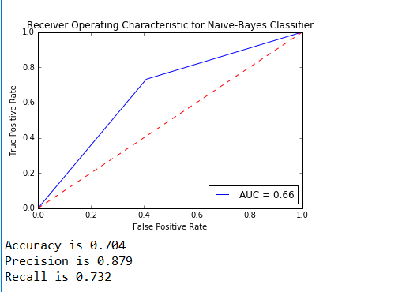
ROC With Bigrams

Slide 8
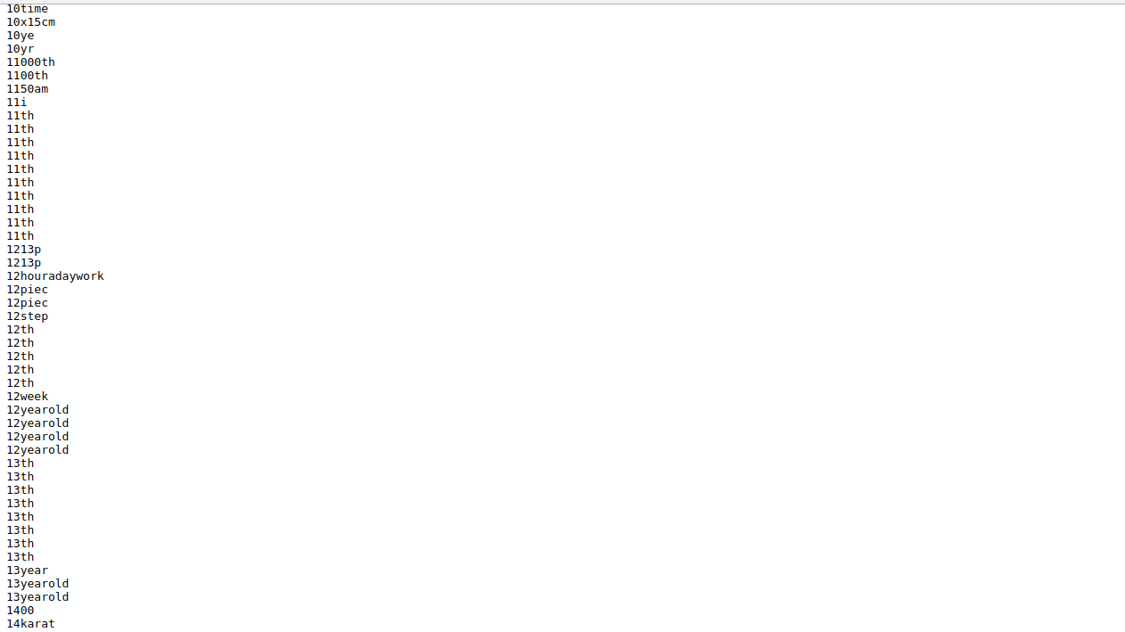
Uni Grams

Slide 9
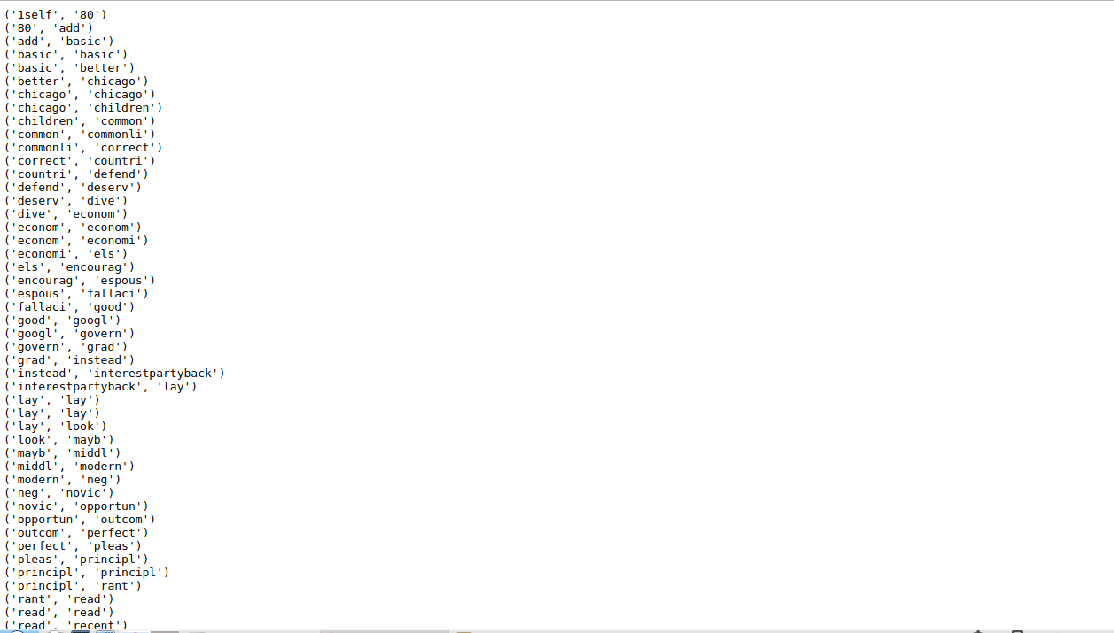
Bi Grams

Slide 10
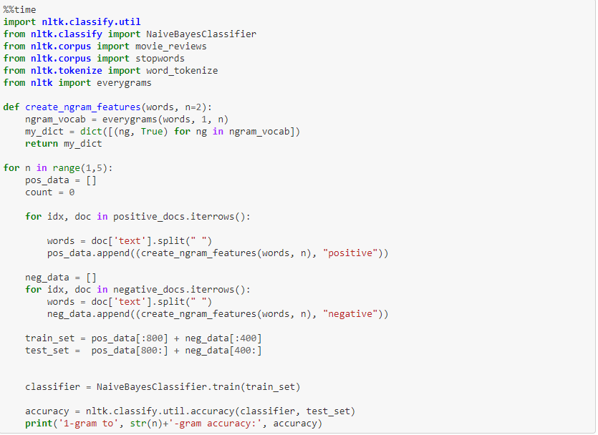
Using NLTK Library

Slide 11
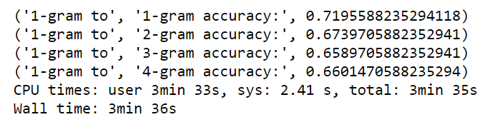
Accuracy Obtained by N-Gram Techniques

Slide 12
Questions?

Slide 13
Thank You

